Slide 1

CPE 490 Embedded Systems Lecture 25
Exam 2 review (finish)
Connectivity and Networks (Chapter 20)

Slide 2
Exam 2 Tuesday 4/
Test is open book open note. (Remember you will not have the internet)
Format – T/F, explain, solve problem read code, write code.
Lectures – 12 through 24.
Concepts learned in lab are fair game.
Homework 4-5

Slide 3
Semaphore and Queues
The RTOS will provide queues for message passing between tasks.
Semaphores are signals that state if something is a ‘go’ or not.
Can be used to lock out peripherals for use by a task
Can be set by interrupts in order to drive event driven tasks.

Slide 4
Task Architecture
It should be a goal to keep the number of tasks to a minimum
One task per deadline
Tasks that are closely related in function and interchange a large amount of data should be made into one task.

Slide 5
How the FreeRTOS Scheduler Works
Each task is assigned a priority when it is created. Other tasks can change the priority of any other task but the kernel can not.
Each task can exist in one of several states. More on this later but the state can be combined into ready to run or not.
Only one task can exist in the running state at one time.

Slide 6
The kernel or schedule works out of a periodic timer ISR called the tick interrupt.
Every interrupt is a time tick that is counted. The highest priority task that is ready is then run until the task blocks itself or the tick interrupt occurs again.
If the task (Task A) that was running before the tick interrupt is not the task (Task B) that runs after the interrupt then Task B pre-empts Task A
If two or more tasks have the same priority and are ready they will be executed in a round robin fashion

Slide 7
Classification of FreeRTOS Scheduler
Fixed Priority Pre-emptive Scheduling
Fixed Priority: each task is assigned a priority at creation, or it can be changed in a task but it is never changed in the kernel.
Pre-emptive: a task entering the ready state will always pre-empt a running task of a lower priority.

Slide 8
Starving a Task
If task 2 has a higher priority then task 1 and task 2 is continuous task it will never relinquish control to task 1.
In this case task 2 starves task 1. We can see that it would be good if task 2 could go to sleep or be blocked for a period of time or until an event occurs.

Slide 9
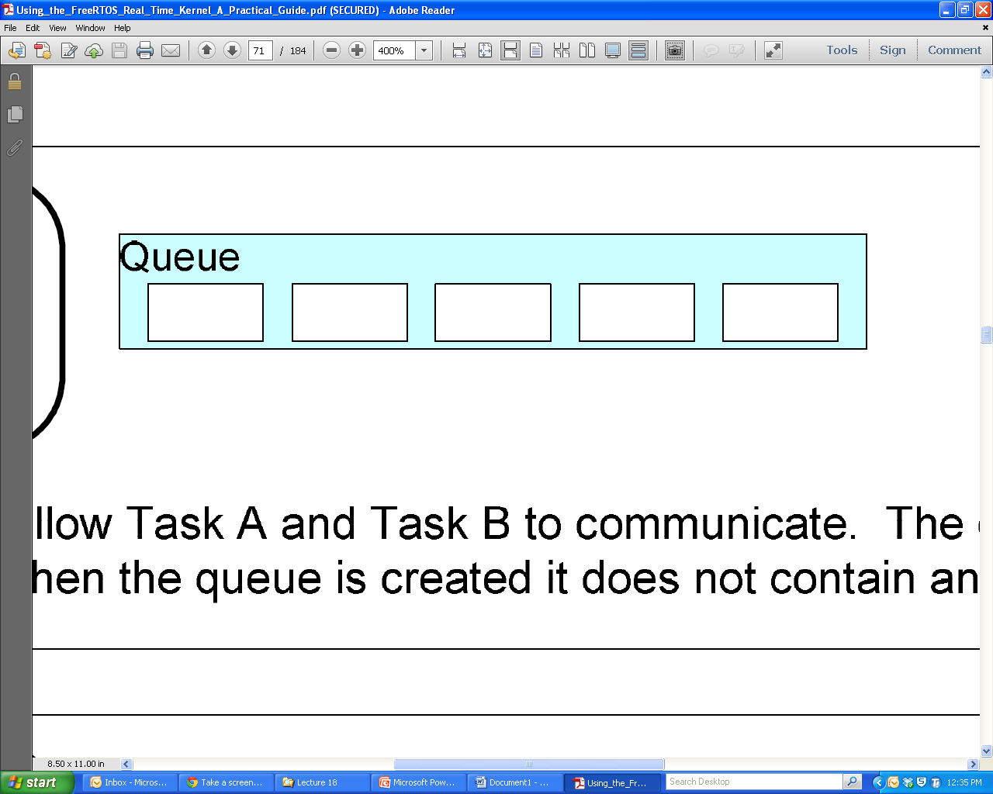
Characteristics of a Queue
A holds a finite number of fixed sized data items
The Length of a queue is the max number of items it can hold
Normally queues are First in First Out (FIFO) buffers
Out
In

Slide 10
Queues as Objects
A queue is its own object not owned by the creator of the task
Multiple writers and readers of the queue are possible
A queue having multiple writers is common, multiple readers is rare.

Slide 11
Blocking on Queue Reads and Writes
If a task wants to read from the queue but the data has not been written yet, the task can block itself until the queue has been written to.
If a task wants to write to the queue but the queue’s length has been reached then a task can block itself waiting for a queue read by another task to occur.
In both cases a task can specify a max amount of time to wait.
Notes:
Multiple readers or writers can be waiting for a read or write to occur only the highest priority task will be unblocked when that occurs. If at the same priority the one that has been waiting the longest will be unblocked.

Slide 12
Binary Semaphore
Can be used to unblock a task each time a particular interrupt occurs. If the unblocked task is of high priority it will run immediately.
This allows the ISR to be very short but still trigger a task very quickly after the event has occurred.
The interrupt processing is said to have been ‘deferred’ to a ‘handler’ task.

Slide 13
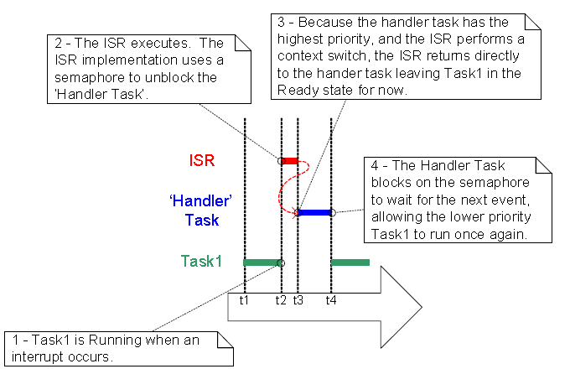
Using Interrupt to Preemptively Change Tasks

Slide 14
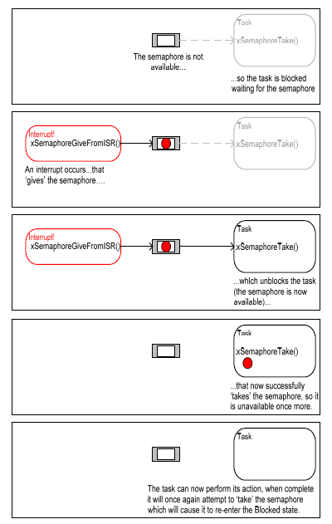
Example of a Semaphore
Think like a queue of length = 1 (binary)
To Give is to put a ‘value’ into the queue
To Take is read a ‘value’ from the queue

Slide 15
Counting Semaphores
A counting semaphore can take a number of ‘gives’ before a ‘take’ occurs
What happens if interrupts can occur at high frequency over a short period of time?
Counting Semaphore can be thought of a queue of n elements
A binary semaphore might get overrun as seen in the next slide

Slide 16
Problems in Data Acquisition
Sampling will always cause some sampling error
Sampling will always cause loss of frequency content. If we sample at rate of X Hz then we can only have a frequency content up to X/2 Hz.
0111 1000
True Analog Value
Sampling error
0111 0111

Slide 17
A Data Acquisition System
When converting an analog signal to digital form, it is usually not enough just to find a suitable ADC (Analog to Digital Converter). Usually, more than one input is required and the signal needs processing before it can be converted. In most cases, therefore, it is necessary to build up a complete data acquisition system. The elements of such a system are shown below. This shows, in block diagram form, a system with multiple inputs, amplification, filtering, source selection, sample and hold, and finally the ADC itself. The different elements are outlined in the sections which follow.
Filter
Multiplexer
Removes unwanted
Selects which
ADC
signal components,
input channel is
Converts its
Voltage
Transducer
usually for
anti-
connected to its
Analog
Input to a
Generates signal
aliasing
purposes
output
Sample & Hold
Digital Output
Reference
Samples its input
signal, and holds
that voltage as a
steady value at its
output
Sample
Digital
Output
Amplify and Offset
Input Select
Start
Output
Amplifies signal and
Conversion
Result
CPU
adds DC offset, to
Conversion
Control
match ADC input
Complete
range.

Slide 18
The Sample and Hold Circuit
Because most ADCs work better converting a stationary voltage, a Sample and Hold circuit is commonly used. In this type of circuit a capacitor is charged from a source which inevitably has some resistance. Further resistance comes from internal resistance of the solid-state switch used in the S&H, and/or in the multiplexer. Therefore the capacitor takes finite time to charge, with a charging characteristic as shown.
A Simple Form of Sample and Hold Circuit
Charging Characteristic of Sample & Hold
Notes:
So how close to Vs must you get, lets say to ½ bit. So an 8 bit converter is 1/255* 1/2 = .196% or X = .9980. This gives a t of RC 6.238

Slide 19
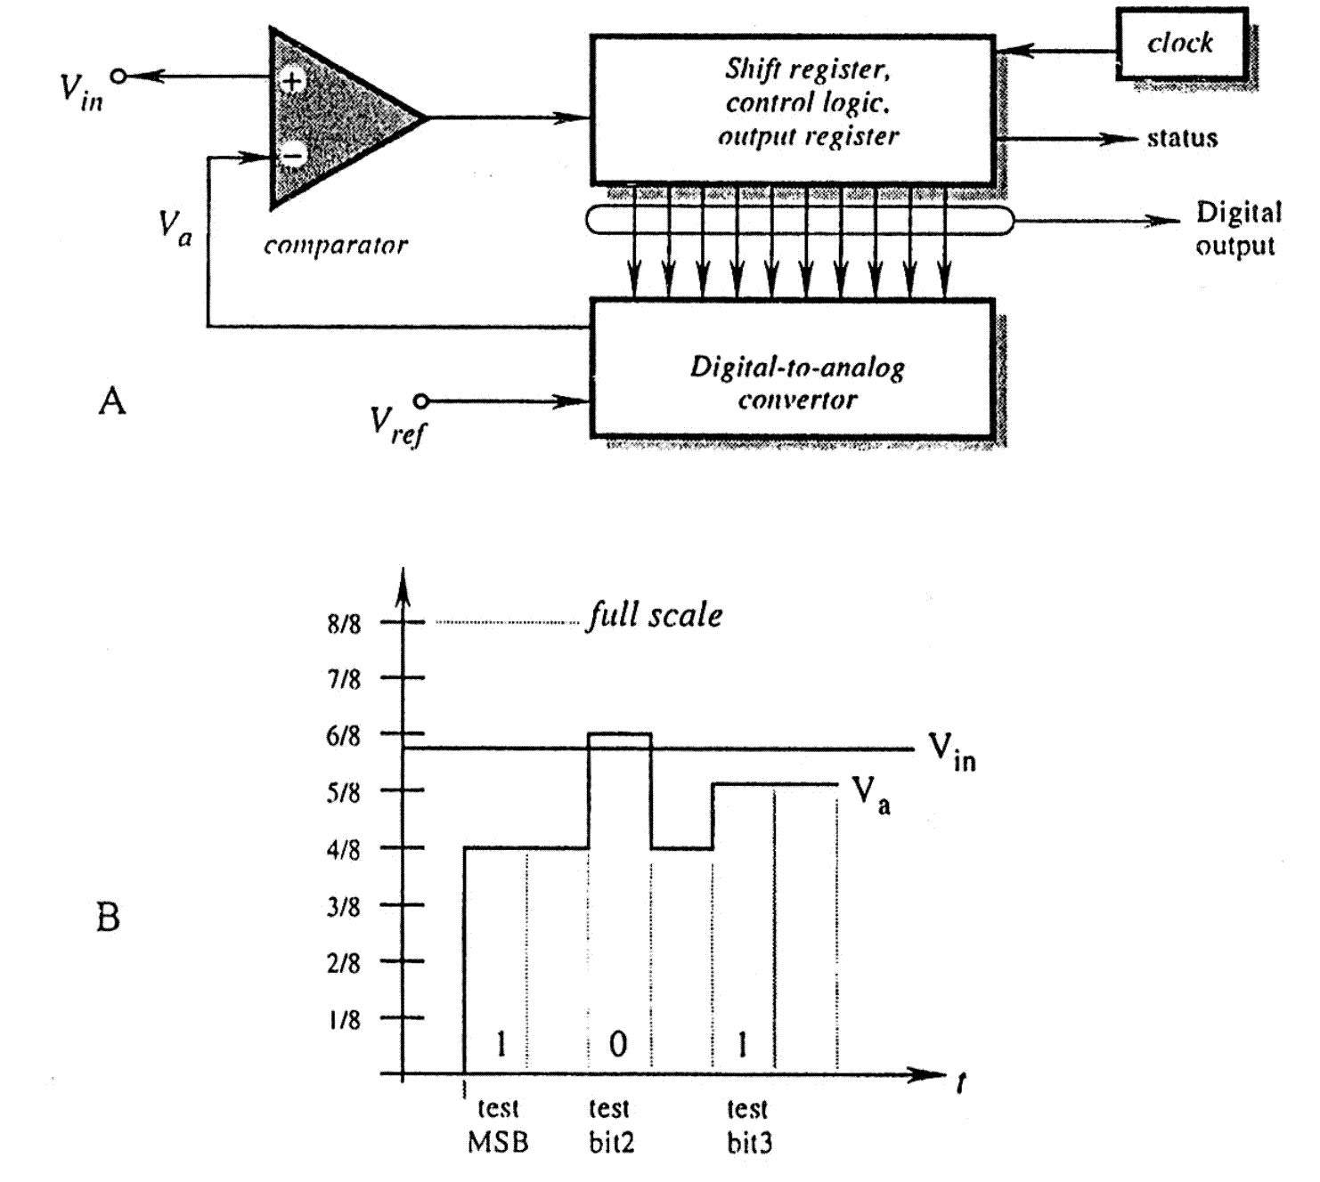
Successive Approximation A/D
Notes:
This is the type of A/D convertor in the dsPIC

Slide 20
The Analog to Digital Converter (ADC)
The ADC accepts an input voltage that is infinitely variable, and converts this to one of a fixed number of output values. An example ADC conversion characteristic is shown, where the input voltage is represented on the horizontal axis, and digital output on the vertical.
For an n-bit ADC, the maximum output value will be (2^{n} – 1). For example, for an 8-bit ADC, the maximum value will be (2⁸ – 1), or (256 – 1), i.e. 255 decimal or 11111111 binary.
Min 0 V = Code 0
Max V_{max} = Code 2^{n} – 1
Resolution = V_{max} /(2^{n} – 1)
Code = D = e/V_{max} (2^{n} – 1)
Digital
Output
n
(2 - 1)
n
(2 - 2)
100
011
010
...001
0
Analogue
0
V
max
Input
Input Range
Notes:
Notice that the change to a code will ideally happen in ½ of the interval of resolutions
Also note that the text has the resolution wrong when it states it is V/2^N

Slide 21
Location of ADC
Two choices:
Integrated in the microcontroller
Separate with some type of interface to the processor
A microcontroller is an electrical noisy place.
Remember many (10s of thousands) transistors change on every clock edge
Hard to get better than 10 bit performance
I separate ADC can be isolated on the PCB to be in a quiet zone.

Slide 22
Typical Timing Requirement of one A to D Conversion
Configure & enable ADC
Select
Multiplexer
input
These stages merge
if
multiplexer
forms
“Sample” Input Signal
part of S&H
Delay for signal acquisition
“Hold” Input Signal
Start Conversion
Delay for conversion
to complete
Read Data

Slide 23
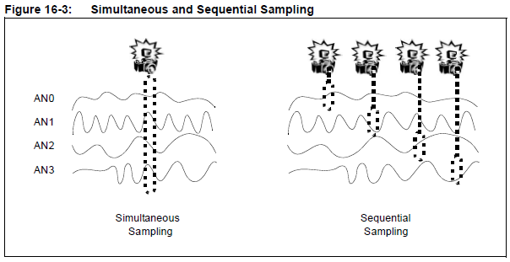
Sampling Mode
Up to 4 channels can be sampled simultaneously
Simultaneous sampling can be important in control and power calculations.
Notes:
You can configure how many sample and hold channels are going to be active for any mode. Choices are:
CH0 Only or
CH0, and CH1 or
CH0, CH1, CH2, and CH3
Remember in 12 bit mode there is only one sample and hold

Slide 24
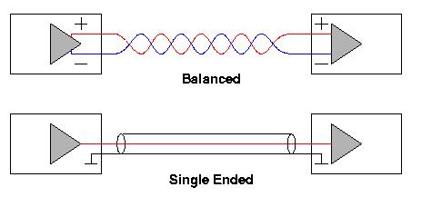
Differential Vs Single Ended
If the signal you want to read is referenced to a common ground then single ended is possible

Slide 25
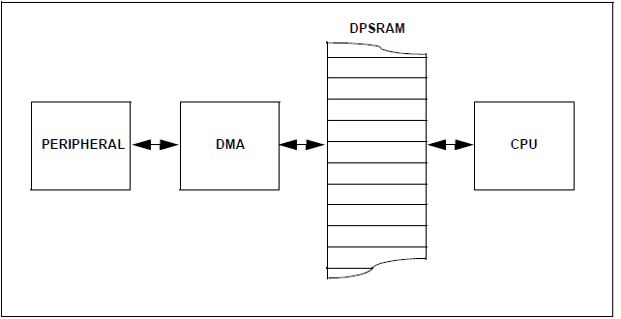
dsPIC33 DMA Structure
Dual Port Static Random Access Memory – prevents bus contention between CPU and DMA peripheral. No cycle stealing needed.
Notes:
The only situation dual port RAM can not handle is when both DMA controller and CPU try to write to the same address. If this occurs a trap is executed, so recovery can be implemented.

Slide 26
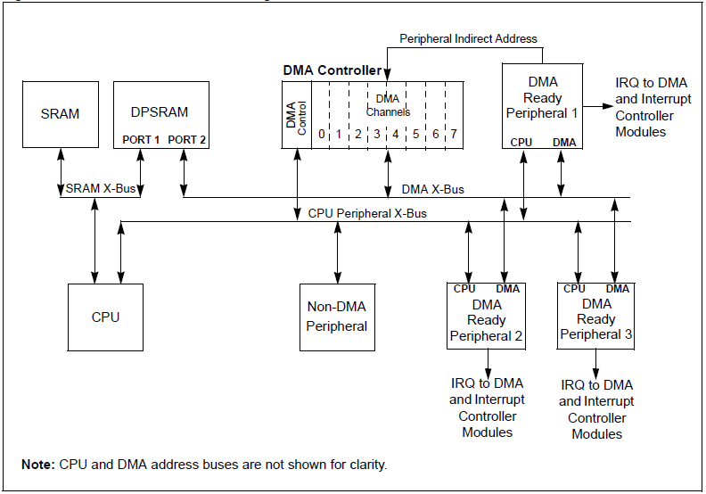
dsPIC33 DMA Block Diagram
Interrupt is DMA Request
One transfer per inst. cycle
Normal Address
Notes:
Make sure to NOT enable the interrupt that will be used to alert the DMA controller to action.

Slide 27
Connectivity and Networks
Chapter 20 of text
We have used communications to establish small primitive networks
LCD controller and PIC
Simple serial interfaces in CPE303
But .. It seems everything is networked these days. Lets discuss this in broad terms.

Slide 28
The Internet of Things IoT
What if all devices in your home, in your vehicles, in factories etc. were all connected to the internet?
Started with Radio Frequency Identification Devices (RFID) that were embedded in materials and goods.
Inventory is computer monitored and up to date in real time.
With smart phones many devices are able to give information and control to anyone in its area.
Notes:
A good example is locking your front door with a smart phone.
Massive amounts of data will be available. Predictive analytics will be made from this data. This collection of information is sometimes called big data

Slide 29
Networks are more than Connectivity
For a network to exist, all nodes must connect to other nodes.
This can be wires, Radio Transmission, or optical signals
Once connected there are still many other things to agree upon
Format if information
How to address one another
How to handle errors
The rules of communication are called Protocols

Slide 30
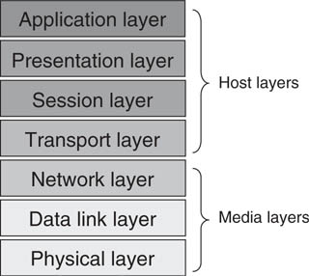
Open System Interconnect Model
The ISO Open Systems Interconnect model
Notes:
OSI is defined by the ISO International Standards Organization
This is a protocol on how to describe a protocol.
Physical – voltage levels, physical connection
Data Link – error checking and correction
Network – How to address nodes
Transport – Message is parsed into logical units, Acknowledgement of messages, traffic control (throttle communications)
Session – allows nodes to establish awareness of each other by creating and destroying sessions
Presentation – formats the data for the application layer
Application – the interface between the application program and the network

Slide 31
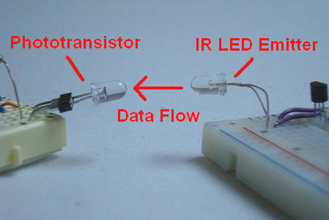
Infrared Connectivity
Pro: Low cost, Simple, Secure, not regulated by the FCC
Con: Line of sight.

Slide 32
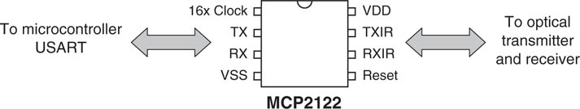
Infrared Connectivity
Infrared communication is a natural area of activity for the small embedded system. Microchip offers several IR encoder/decoder ICs. The MCP2122, as shown, interfaces between a microcontroller on one side, and infrared source and receiver on the other.
The Microchip MCP2122 infrared encoder/decoder
Notes:
Main point chip sets exists for quick designs.

Slide 33
Radio Connectivity
No longer line of sight.
How do you handle variable numbers of talkers and receivers in the same area?
How do you know who you are talking to
How do you not transmit over each other.

Slide 34

Low power 1 mW,
Transmits 2.402-2.48 GHz (ISM)
Typical Range 10 m
Original data rate 1 Mbps (up to 24 Mbps now)
Autonomously configures network (piconet)
Up to 8 devices in a piconet
Multiple piconets can exists in the same area
Spread-Spectrum frequency hopping at random, 1600 timer per second
Collision detection
Notes:
ISM industry scientific and medical applications

Slide 35

Lower cost and simpler than Bluetooth.
Less software to implement
Two types of nodes
Full Function Device (FFD): Can route data, Can be a coordinator
Reduced Function Device (RFD): Can only talk to FFD. Minimal memory and functionality. Low power due to sleep mode.

